Slide 1
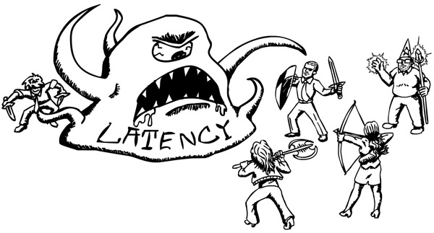
How not to measure latency

Slide 2
Latency Behavior
Latency → time it took for one operation execution
Each operation has its own latency
“continusly meassure” each operation
We care how latency behaves
How to make sense of “millions of numbers”
Can not be represented as one number

Slide 3




What does the Average mean ??
Maxium observed latencies in 15 minutes
[1, 0, 3, 1, 601, 4, 2, 8, 0, 3, 3, 1, 1, 0, 2]
Average: 42
Is there any value for this number ??!!!

Slide 4
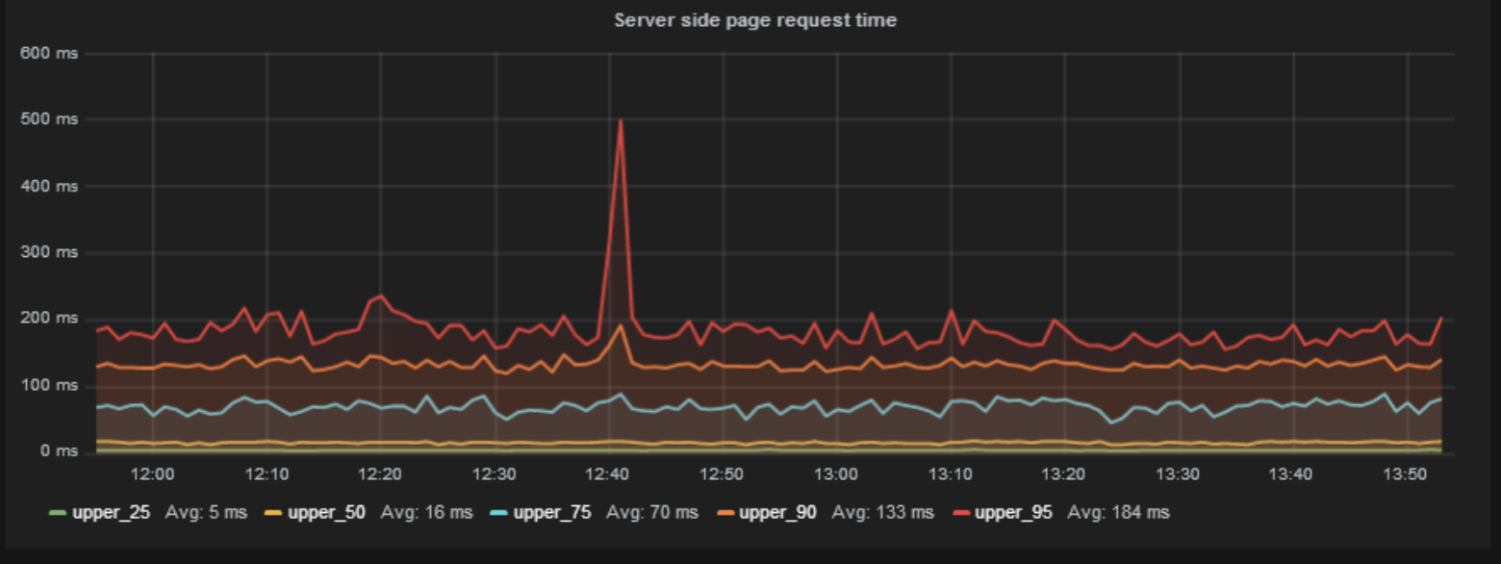
Pretty charts
What is wrong with this graph? Eveyrhing!

Slide 5

Pretty charts

Slide 6

Pretty charts

Slide 7
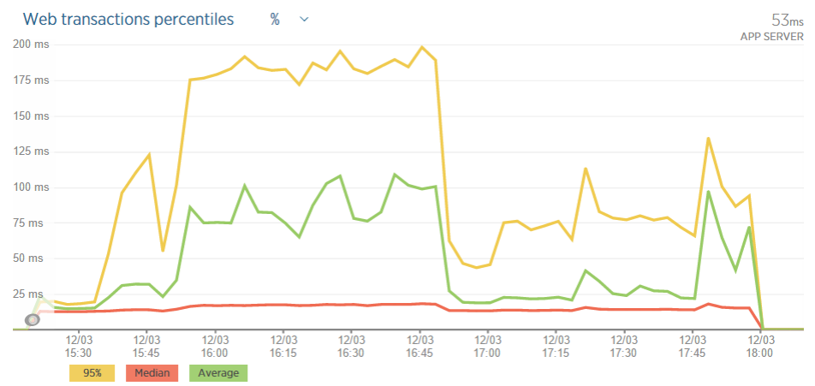
Pretty charts

Slide 8
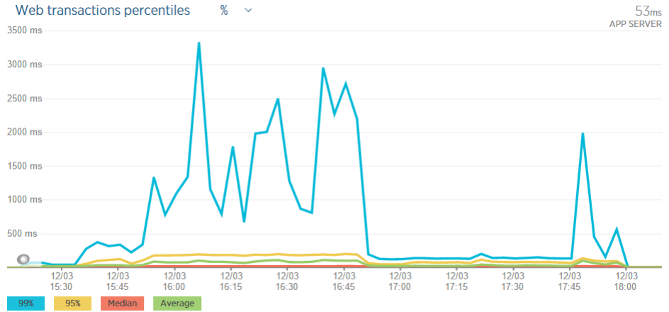
Pretty charts

Slide 9
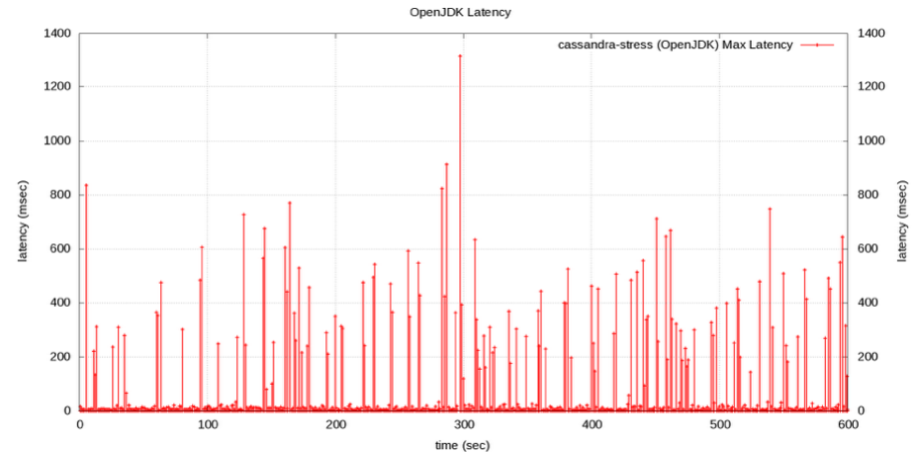
Max latency chart

Slide 10
Is the 99% “rare”?
99% should be good indicator right ?
What are the chances of a single web page experiencing 99% percentile ?

Slide 11
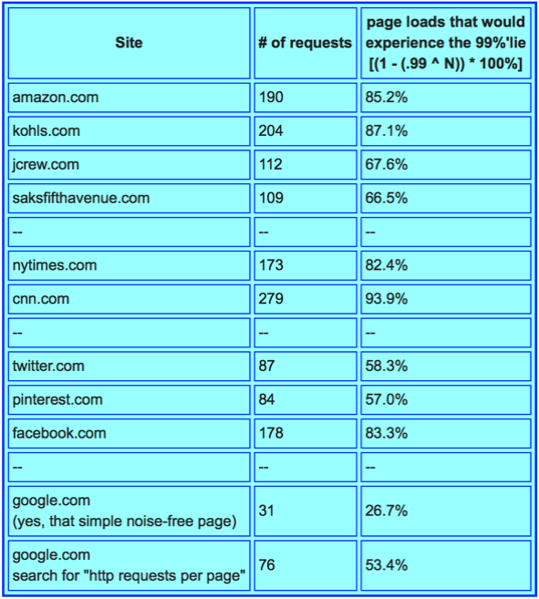

Is the 99% “rare”?

Slide 12

How many % ?
What is more “representative”
The 95%’lie or the 99.9%’lie
How many nines should we care about
We are not “bulding rockets”

Slide 13
How many % ?
Example: user session involves 5 page loads, with 40 resources per page.
- How many of our users will NOT experience
something worse than the 95%’lie of http requests?
Answer: ~0.003%

Slide 14
How many % ?
Example: user session involves 5 page loads, with 40 resources per page.
- How may of our users will experience at least one
response that is longer than the 99.9%’lie?
Answer: ~18%
How many users will experience something worse than avreage ? :) :)

Slide 15
User experience
Example: If a typical user session involves 5 page loads, averaging 40 resources per page
- What http response percentile will be experienced by the 95%’ile of users?
Answer: ~99.97%
- What http response percentile will be experienced
by the 99%’ile of users
Answer: ~99.995%

Slide 16
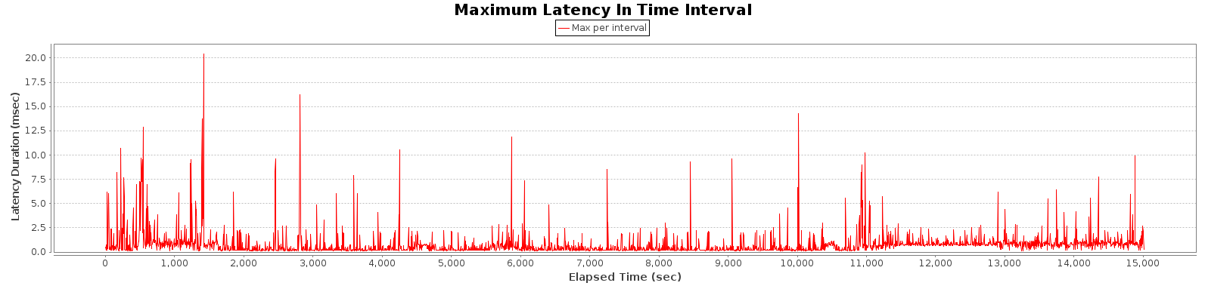
Latency shape
Not a normal distribution
4 hours run “control” java process on home latpop
“Hiccups” even if no load present

Slide 17
Common ways people deal with hiccups

Slide 18
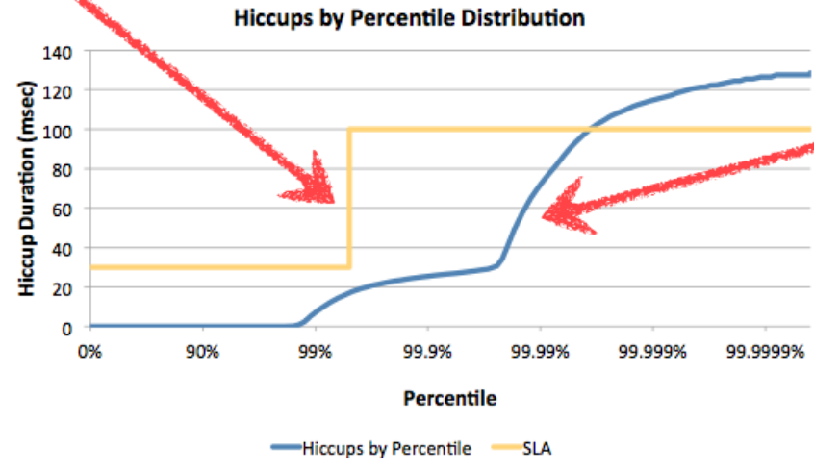
Better ways people can deal with hiccups

Slide 19
Better ways people can deal with hiccups

Slide 20
How to capture latency?
Reason why people “averaging” latency is because they don’t know how to capture it
HdrHistogram: https://github.com/HdrHistogram
Can capture all points with “no cost”
JHiccup https://www.azul.com/jhiccup/

Slide 21
Coordinated omission
Great so we measure everything and we are done, right ?
Coordinated Omission (“CO”) is the measurement error which is introduced by naively recording requests, sorting them and reporting the result as the percentile distribution of the request latency.

Slide 22
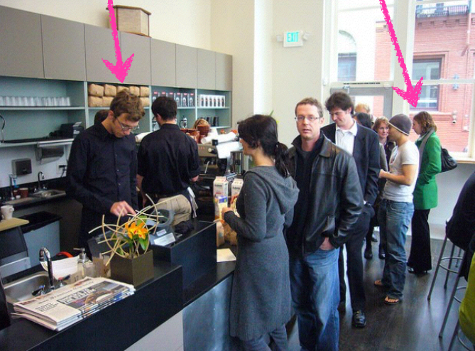
Coordinated omission
Service time VS response time
Cooridante ommision → service time instead of response time

Slide 23
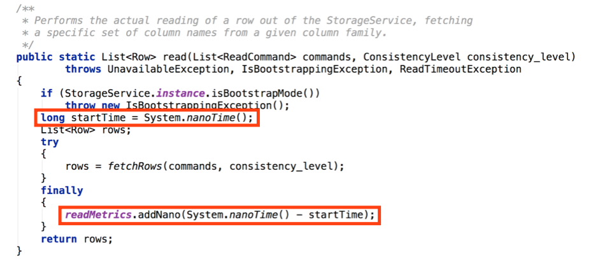
Coordinated omission

Slide 24
Coordinated omission
Common mistakes:
* meassure “on server”
* use “bad” load generator (jMeter, etc.)
Not trivial to find a good load generator

Slide 25
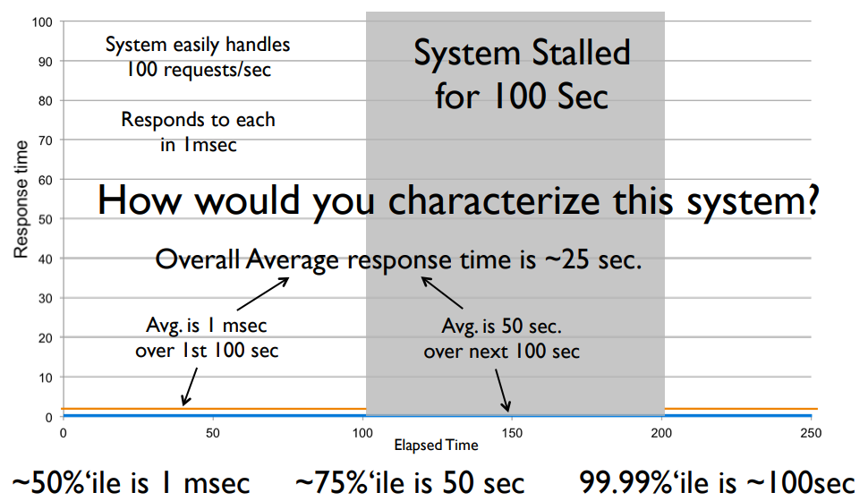
How bad can this get?

Slide 26
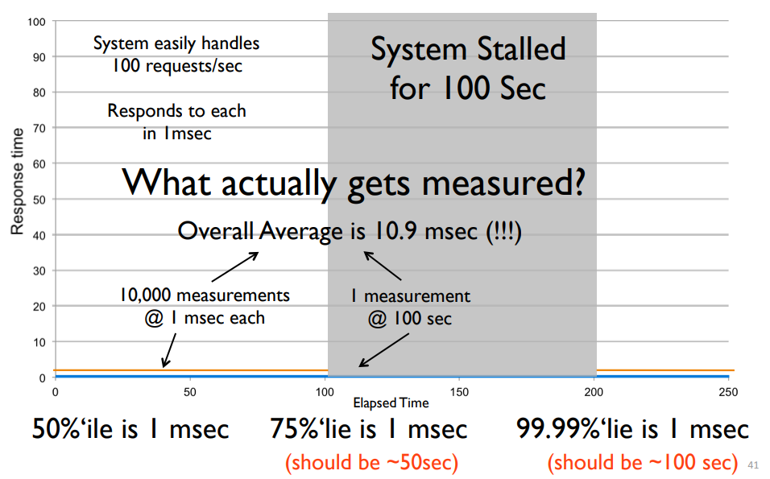
Measurement in practice

Slide 27
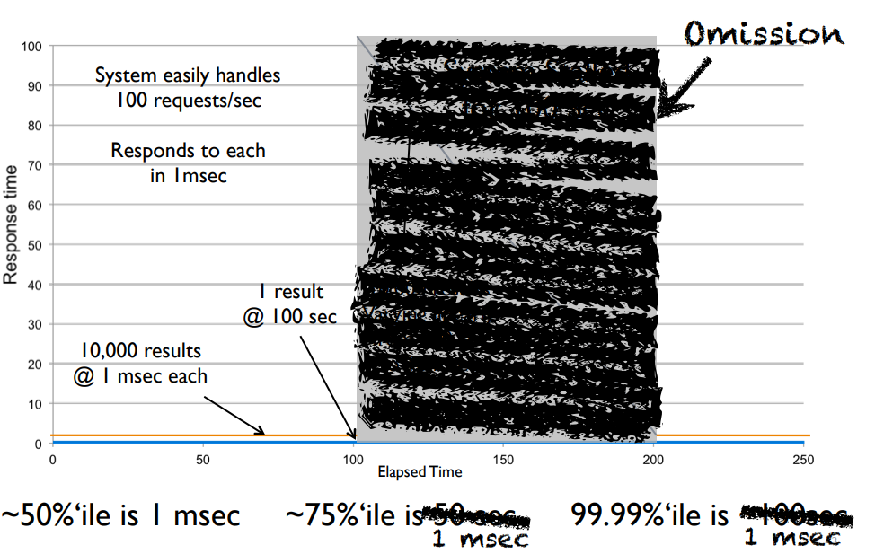
Measurement in practice

Slide 28
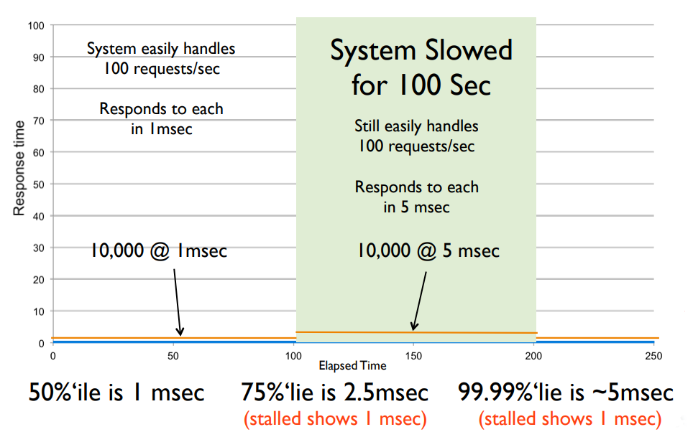
“Better” can look “Worse”

Slide 29
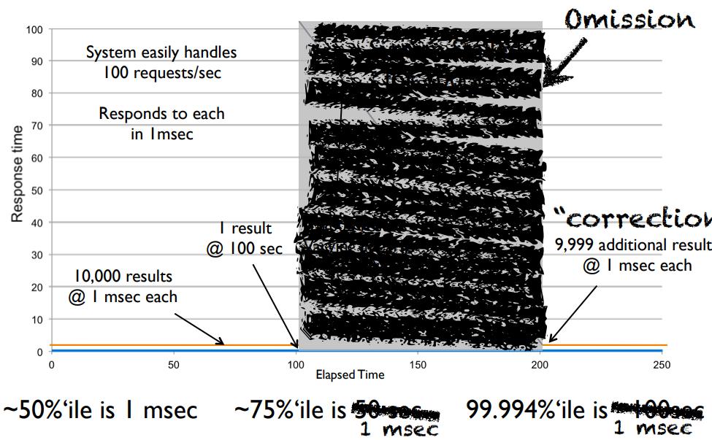
“Correction”: “Cheatng Twice”

Slide 30

It is important to meassure correctly
If we “improve” bad chart will the user be happy?

Slide 31
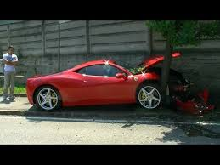
Sustainable Throughput
Meassure system which works

Slide 32

Thank you

